Slide 1



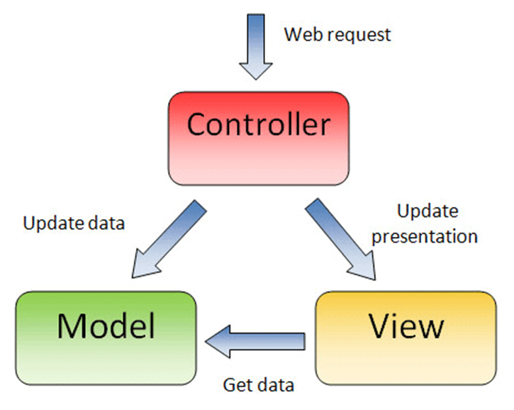

MVC Advanced & Reflection
Reflection, Parsing Dynamic Data, Asynchronous Requests
Web Development Basics
SoftUni Team
Technical Trainers
Software University
http://softuni.bg

Slide 2

Table of Contents
Reflection
ViewHelpers
AJAX Calls
Grids
Authorization API

Slide 3

Reflection
Description, Reflection in PHP, Examples

Slide 4
Reflection
Program's ability to inspect itself and modify its logic at execution time.
Asking an object to tell you about its properties and methods, and altering those members (even private ones).
Most programming languages can use reflection.
Statically typed languages, such as Java, have little to no problems with reflection.

Slide 5
Reflection in PHP
Dynamically-typed language (like PHP or Ruby) is heavily based on reflection.
When you send one object to another, the receiving object has no way of knowing the structure and type of that object.
It uses reflection to identify the methods that can and cannot be called on the received object.

Slide 6
When Should We Use Reflection?
Dynamic typing is probably impossible without reflection.
Aspect Oriented Programming listens from method calls and places code around methods, all accomplished with reflection.
PHPUnit relies heavily on reflection, as do other mocking frameworks.
Web frameworks in general use reflection for different purposes. Laravel makes heavy use of reflection to inject dependencies.
Metaprogramming is hidden reflection.
Code analysis frameworks use reflection to understand your code.

Slide 7
Examples
get_class() - Returns the name of the class of an object
<?php
class user {
function name() {
echo "My name is " , get_class($this);
}
}
$pesho = new foo();
echo "It’s name is " , get_class($pesho);
$pesho->name();
// external call
output: “Its name is user”
// internal call
output: “My name is user”

Slide 8
Examples (2)
get_class_methods() - Gets the class methods' names
<?php class MyClass { function myClass() { } function myFunc1() { } function myFunc2() { } }
Result
array(3) {
[0]=> string(7) "myclass
[1]=> string(7)"myfunc1“
[2]=> string(7) "myfunc2“
}
$class_methods = get_class_methods( 'myclass‘ );
or $class_methods = get_class_methods( new myclass() ); var_dump( $class_methods );

Slide 9
Examples (3)
method_exists() - Checks if the class method exists
<?php class MyClass {
function myFunc() { return true; } } var_dump( method_exists( new myclass, 'myFunc‘ ) );
var_dump( method_exists( new myclass, ‘noSuchFunc‘ ) );
bool(true)
bool(false)

Slide 10
Reflector and ReflectionClass
Reflector is an interface implemented by all exportable Reflection classes.
The ReflectionClass class reports information about a class.
<?php class MyClass { public $prop1 = 1; protected $prop2 = 2; private $prop3 = 3; } $newClass = new Foo();
$reflect = new ReflectionClass( $ newClass ); $properties = $reflect->
getProperties( ReflectionProperty::IS_PUBLIC | ReflectionProperty::IS_PROTECTED ); foreach ( $properties as $property ) { echo $property -> getName() } var_dump( $props );
Returns properties names
$prop1
$prop2
$prop3
array(2) {
[0]=> object(ReflectionProperty)#3 (2) {
["name"]=> string(5) "prop1"
["class"]=> string(7) "MyClass"
}
…}

Slide 11

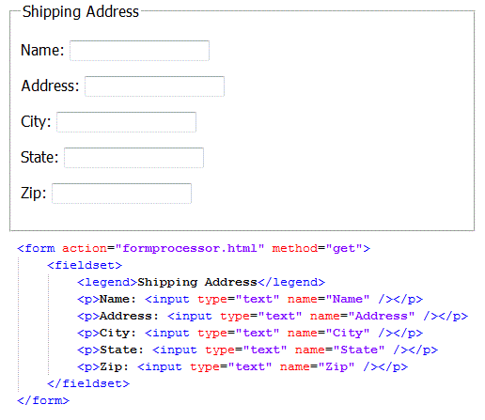
ViewHelpers
ViewHelpers in ASP.NET, MVC / Laravel

Slide 12
ViewHelpers
Separate the application logic from data visualization
Common use cases for view helpers include:
Accessing models
Performing complex or repeatable display logic
Manipulating and formatting model data
Persisting data between view scripts

Slide 13
Examples
class View
{
private $controllerName;
private $actionName;
public function __construct($controllName, $actionName)
{
$this->controllerName = $controllName;
if (!$actionName) {
$actionName = 'index';
}
$this->actionName = $actionName;
}
public function render()
{
require_once '/Views/' . $this->controllerName
. '/' . $this->actionName . '.php';
}

Slide 14
Examples (1)
public function url($controller = null, $action = null, $params = [])
{
$requestUri = explode('/', $_SERVER['REQUEST_URI']);
$url = "//" . $_SERVER['HTTP_HOST'] . "/";
foreach ($requestUri as $k => $uri) {
if ($uri == $this->controllerName) break;
$url .= "$uri";
}
if ($controller)
$url .= "/$controller";
if ($action)
$url .= "/$action";
foreach ($params as $key => $param)
$url .= "/$key/$param";
return $url;
}

Slide 15
Examples (2)
public function partial($name)
{
include 'Views/Partials/' . $name . ".php";
}
URL ViewHelper example

Slide 16
Examples (3)
Ajax Form in ASP.NET
@using (Ajax.BeginForm("PerformAction",
new AjaxOptions
{
OnSuccess = "OnSuccess",
OnFailure = "OnFailure"
}))
{
<fieldset>
@Html.LabelFor(m => m.EmailAddress)
@Html.TextBoxFor(m => m.EmailAddress)
<input type="submit" value="Submit" />
</fieldset>
}

Slide 17

AJAX Calls
Asynchronous JavaScript and XML

Slide 18
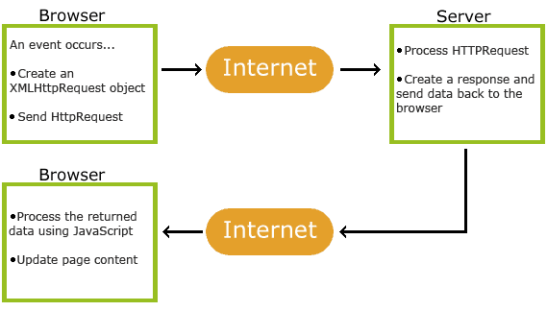
What is AJAX
AJAX is a technique for creating fast and dynamic web pages.
AJAX allows web pages to be updated asynchronously – update parts of a web page, without reloading the whole page.
How AJAX works

Slide 19
Example (1)
public function delete() {
if ($this->request->id) {
$topic_id = $this->request->id;
$topic = $this->app->TopicModel->find($topic_id);
$isOwnTopic = $topic->getUserId() == $this->session->userId;
if ($isOwnTopic || $this->isAdmin) {
if ($this->app->TopicModel->delete($topic_id)) {
return new Json(['success' => 1])
}
}
}
return new Json(['success' => 0]);
}

Slide 20
Example (2)
$("#deleteTopic").click(function() {
var topic = $(this);
$.post("<?= $this->url('topics', 'delete');?>",
{
id: $this->topic['id']
}).done(function (response){
var json = $.parseJSON(response);
if (json.success == 1) {
topic.hide();
}
});
})

Slide 21
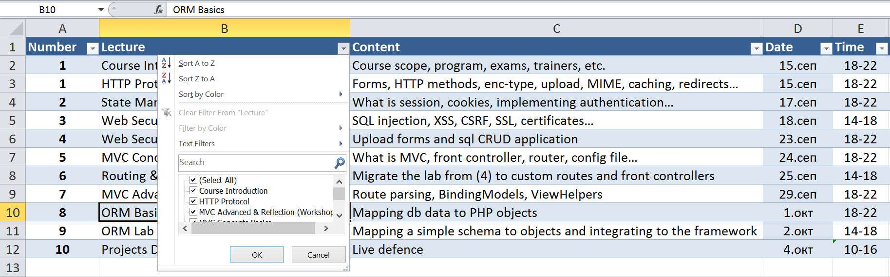
GRID
Former name for AIDS

Slide 22

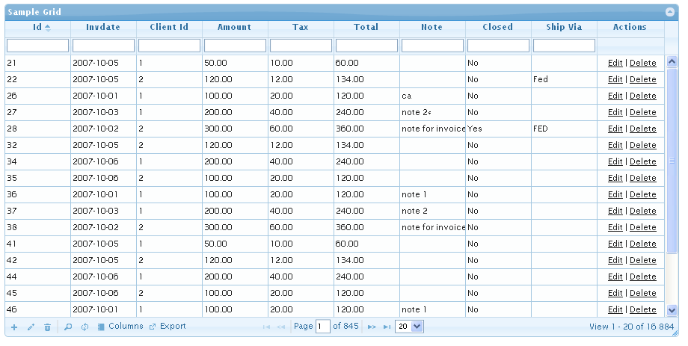
What is GRID
GRIDs are tools for representing data as a table
Usually very extensive and customizable
Have a lot of filtering options
Column contents filtering
Column show/hide
Column sorting
Row children

Slide 23
Kendo UI GRID
Html.Kendo().Grid<Kendo.Mvc.Examples.Models.CustomerViewModel>()
.Name("grid")
.Columns(columns =>
{
columns.Bound(c => c.ContactName).Width(240);
columns.Bound(c => c.ContactTitle).Width(190);
columns.Bound(c => c.CompanyName);
})
.HtmlAttributes(new { style = "height: 380px;" })
.Scrollable()
.Groupable()
.Sortable()
.Pageable(pageable => pageable
.Refresh(true)
.PageSizes(true)
.ButtonCount(5))
.DataSource(dataSource => dataSource
.Ajax()
.Read(read => read.Action("Customers_Read", "Grid")) )

Slide 24
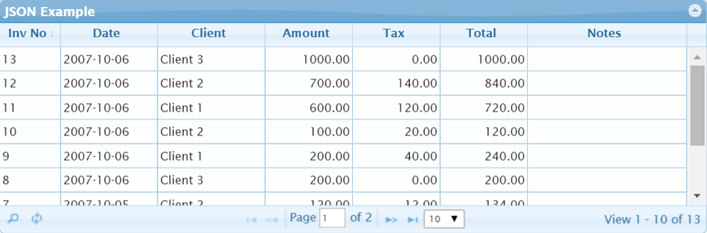
jqGrid
jQuery("#list2").jqGrid({
url:'server.php?q=2',
datatype: "json",
colNames:['Inv No','Date', 'Client', 'Amount'],
colModel:[
{name:'id',index:'id', width:55},
{name:'invdate',index:'invdate', width:90},
{name:'name',index:'name asc, invdate', width:100},
{name:'amount',index:'amount', width:80, align:"right"}
],
rowNum:10,
rowList:[10,20,30],
pager: '#pager2',
sortname: 'id',
viewrecords: true,
sortorder: "desc",
caption:"JSON Example"
});

Slide 25
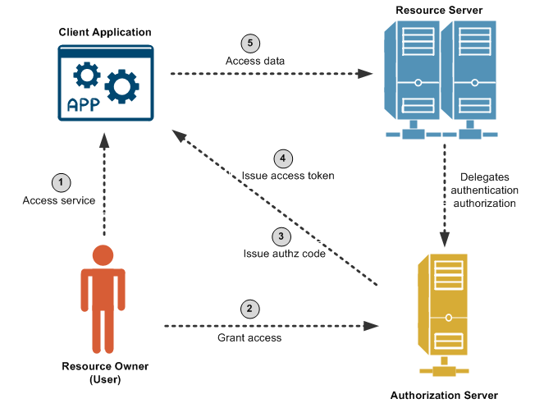
Authorization API

Slide 26
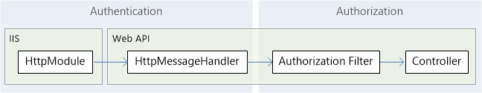
Authentication & Authorization
Authentication is knowing the identity of the user.
Authorization is deciding whether a user is allowed to perform an action.

Slide 27
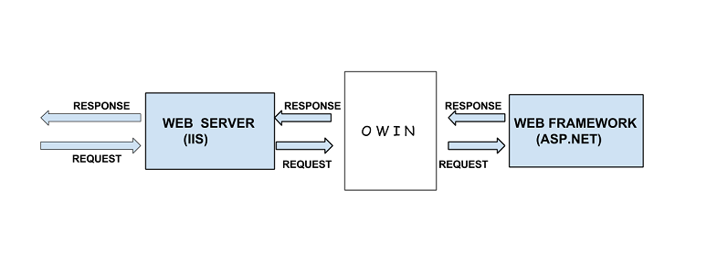
ASP.NET Owin API
OWIN defines a standard interface between .NET web servers and web applications. The goal of the OWIN interface is to decouple server and application
Understanding OWIN Authentication/Authorization

Slide 28










MVC Advanced & Reflection
https://softuni.bg/courses/web-development-basics/

Slide 29
License
This course (slides, examples, demos, videos, homework, etc.) is licensed under the "Creative Commons Attribution-NonCommercial-ShareAlike 4.0 International" license

Slide 30






Free Trainings @ Software University
Software University Foundation – softuni.org
Software University – High-Quality Education, Profession and Job for Software Developers
softuni.bg
Software University @ Facebook
facebook.com/SoftwareUniversity
Software University @ YouTube
youtube.com/SoftwareUniversity
Software University Forums – forum.softuni.bg

